Slide 1
20CYS315
AUTOMATA THEORY AND COMPILER DESIGN
Dr.Anusuya

Slide 2
Course Objectives
To provide an overview of the problems that can be solved by various kinds of abstract machines such as finite state machine and pushdown automata.
To understand how lexical analysis and syntax analysis are done using regular expressions and context free grammars respectively.
To understand various intermediate representations and code generation algorithms for compiler design.

Slide 3
Course Outcomes
CO1: To understand various intermediate representations and code generation algorithms for compiler design.
CO2: Apply the concepts of finite automata and regular expressions for the lexical analysis of a program.
CO3: Demonstrate the push down automata and context free grammar to recognize Context free languages and apply the same for syntax analysis or parsing.
CO4: Generate intermediate code and target code for a simple compiler.

Slide 4
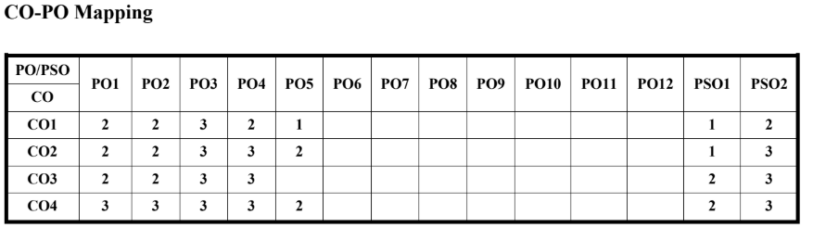

Slide 5
Syllabus
Unit 1
Finite State Machines: Deterministic Finite Automata (DFA) - Non-Deterministic Finite Automata (NFA) - Equivalence of NFA and DFA - Minimization of DFA - Regular Expression Regular Language - Properties of Regular Languages - Definition of a compiler - phases of compiler - Lexical Analysis.
Unit 2
Context Free Languages (CFL) and Parsing: Pushdown Automata - Context Free Grammar (CFG) – Properties of CFL - Normal Forms - Syntax analysis - top-down parser - Non recursive predictive parser - Bottom-up parser – SLR - CLR.

Slide 6
Unit 3
Intermediate Representations: Abstract Syntax Tree, Three Address Code - Symbol Tables - Basic blocks - Flow graphs. Code generation: A simple code generation Algorithm - code generation.

Slide 7
Text Book(s)
1. Linz P, An Introduction to Formal Languages and Automata. Sixth edition, Jones and Bartlett Learning; 2016.
2. Cooper, Keith, and Linda Torczon, Engineering a Compiler, Second Edition, Morgan Kaufman, 2011.
Reference(s)
1. Hopcroft JE, Motwani R, Ullman JD. Introduction to Automata Theory, Languages and Computation.
Third Edition, Pearson; 2006.
2. Aho, Alfred V., Monica S. Lam, Ravi Sethi, and Jeffrey Ullman, Compilers: Principles, Techniques and
Tools, Prentice Hall, Second Edition, 2006
3. Parr T. Language implementation patterns: create your own domain-specific and general
programming languages. Pragmatic Bookshelf; First Edition, 2010.
4. Mak R. Writing compilers and interpreters: a software engineering approach. John Wiley & Sons;
Third Edition, 2009.

Slide 8
Theory of Computing
To know the foundations and principles of computer science.
Branch that deals with how efficiently problems can be solved on a model of computation, using an algorithm.
Automata Theory is studied because it provides the theoretical foundation upon which much of computer science is built.
Branches:
  Automata Theory
  Computability Theory
  Computational Complexity Theory

Slide 9
Automata Theory
Automata theory helps us understand the capabilities and limitations of different computational models like finite automata, pushdown automata, and Turing machines.
These models serve as the building blocks for understanding more complex machines (like real computers).

Slide 10
Computability Theory
This area focuses on understanding the limits of computation. Not all problems can be solved by a computer, and computability theory helps identify which problems are solvable (decidable) and which are not (undecidable).

Slide 11
Complexity Theory
Complexity theory extends computability theory by classifying problems based on how efficiently they can be solved. It deals with the time and space resources required to solve computational problems.

Slide 12
Automata
Automaton is a model that processes input and produces output.
Types of Automata
Finite State Machines
Push Down Automata
Linear Bound Automata
Turing Machine

Slide 13
Objective of studying Automata Theory
  provides abstract models that capture the essential features of computation independent of hardware or software
  immediate and practical applications digital circuit design, compiler construction, programming language syntax, and pattern recognition
  develops analytical and problem-solving skills

Slide 14
Finite Automata
Automaton is a model that processes input and produces output.
A Finite Automaton (FA)/Finite State Machines, also called a Finite Accepter, is a mathematical model of computation with:
A finite set of states.
  A start state and one or more final (accepting) states.
  A transition function that determines the next state based on current input
It reads input symbol by symbol, and determines whether to accept or reject the string.

Slide 15
Finite Automata
Symbol – Smallest building blocks. Example: a,b,c,0,1,2,3,…
Alphabets (Σ)
A finite, non-empty set of symbols
  Example:
    Σ = {0, 1}, the binary alphabet
    Σ = {a, b, … , z}, the set of all lower-case letter
    The set of all ASCII characters

Slide 16
Strings
  A string (or word) is a finite sequence of symbols chosen from some alphabet
  Example
    1011 is a string from alphabet S = {0, 1}
  Empty string, ε , a string with zero occurrences of symbols
  Length |w| of string w the number of positions for symbols in w
    Examples:
    |0111|= 4,
    |ε|=0

Slide 17
Language – set of strings
Examples:
There exists a Language L1 over Σ = {0,1} such that it contains set of all strings of all length 2
Then The set of strings possible in L1 = {00,01,10,11}
L2 -> set of all strings of length 3 over Σ = {0,1}
={000,001,010,011,100,101,110,111}
L3 -> set of all strings that begin with 0
={0, 01,001,010, 0000,0010,….}

Slide 18
In the examples, L1 & L2 are finite sets
and L3 –is an infinite set
The cardinality of a language in automata theory refers to the number of strings in the language, which can be finite or infinite
Denoted by |L|

Slide 19
Powers of Σ
Eg: If Σ = {0,1}
Σ⁰= Set Of All Strings Of Length 0 = {ε}. ∣ Σ⁰ ∣=1
Σ ¹=Set Of All Strings Of Length 1={0,1} ∣ Σ ¹ ∣=2
Σ ²=Set Of All Strings Of Length 2={00,01,10,11} ∣ Σ ² ∣=4
Σ ³=Set Of All Strings Of Length 3 ={000,001,010,011,100,101,110,111}
∣ Σ ³ ∣=8
Σ ^{n}=set of all strings of length n. ∣ Σ ^{n}∣ = 2^{n}

Slide 20
Σ *= Σ ⁰ UΣ ¹ UΣ ² UΣ ³ U….
It is the set of all possible strings of all lengths over {0,1}
Number of languages possible over Σ * is infinite

Slide 21
Finite Automata
With Output
Moore Machine
Mealy Machine
Without Output
DFA
NFA
ε-NFA

Slide 22
Working Principle of FA
Input Tape:
  Inputs are written on a tape, read by automaton but cannot change it
  Input tape is divided into cells, each of which can hold one symbol
Finite Automaton
  Finite number of states
  Control state transitions / changes
Input Tape
String
Output
Finite
Automaton
[Control Unit]
“Accept”
or
“Reject”

Slide 23
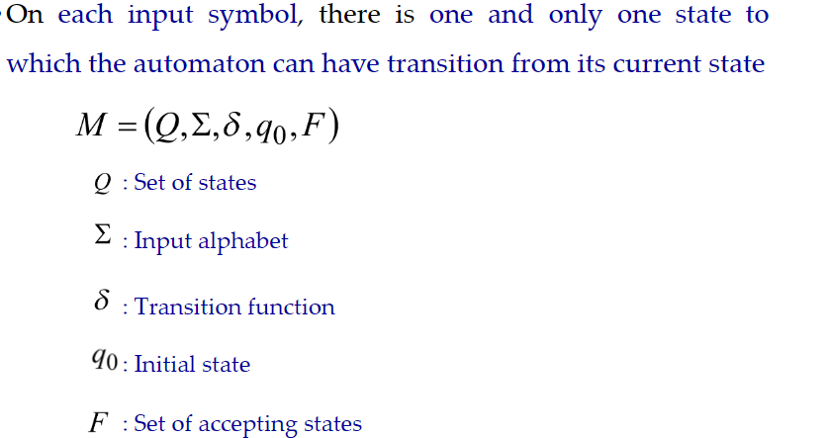
Deterministic Finite Automaton (DFA)

Slide 24
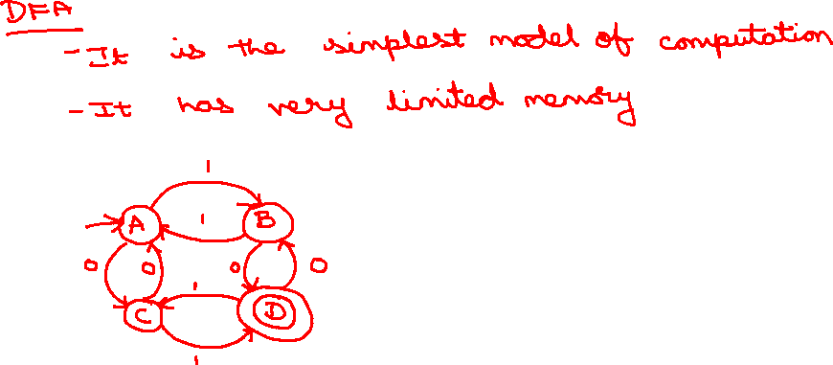

Slide 25
The initial state will be identified by an incoming unlabeled arrow not originating at any vertex.
Final states are drawn with double circles.
For the above example
Q={A,B,C,D}
Σ={0,1}
q₀=A
F={D}

Slide 26

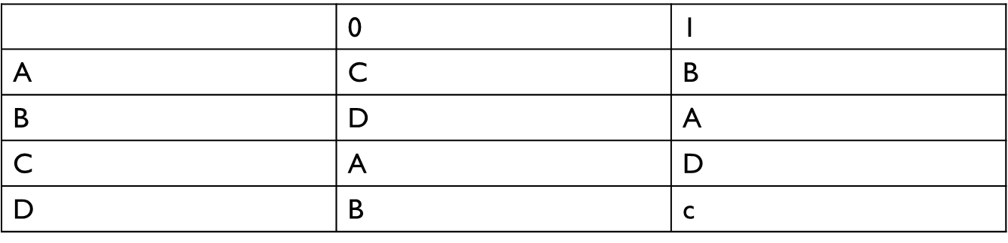
Transition Function

Slide 27
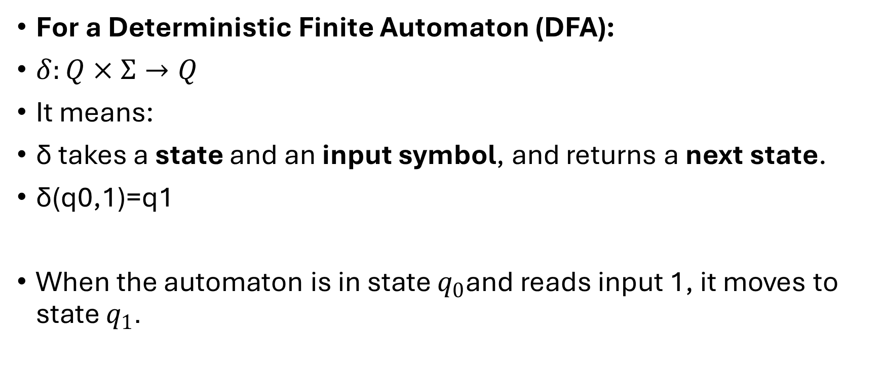
For a Deterministic Finite Automaton (DFA):
$δ:Q×Σ→Q$
It means:
δ takes a state and an input symbol, and returns a next state.
δ(q0​,1)=q1​
When the automaton is in state $q_{0}$and reads input 1, it moves to state $q_{1}$.

Slide 28
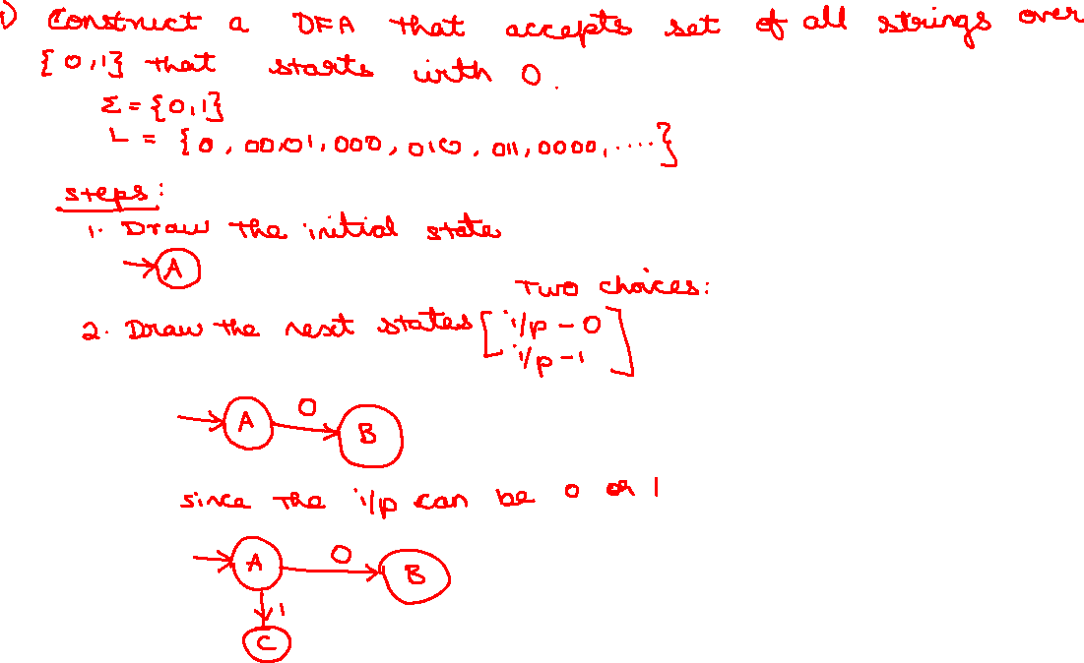

Slide 29
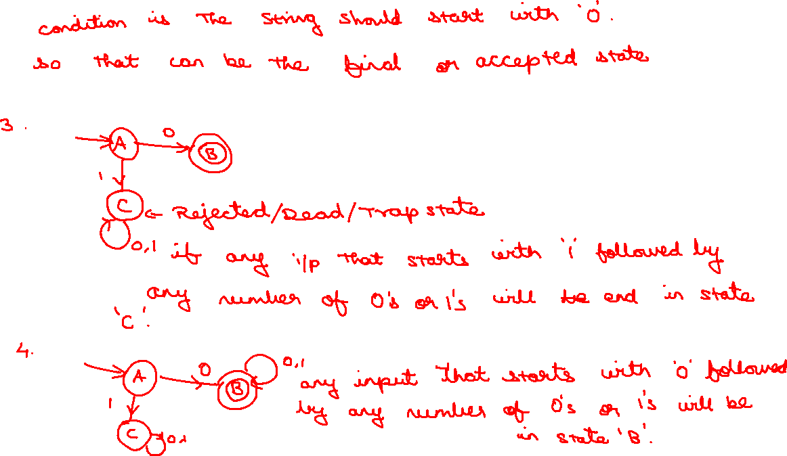

Slide 30
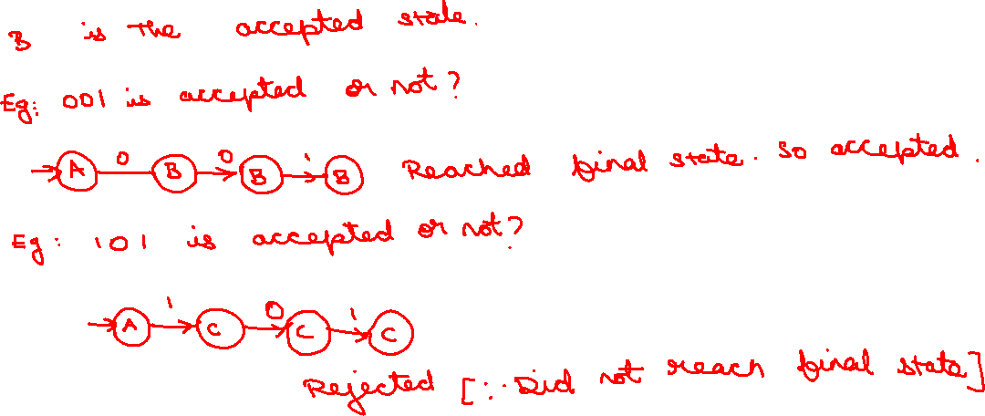

Slide 31
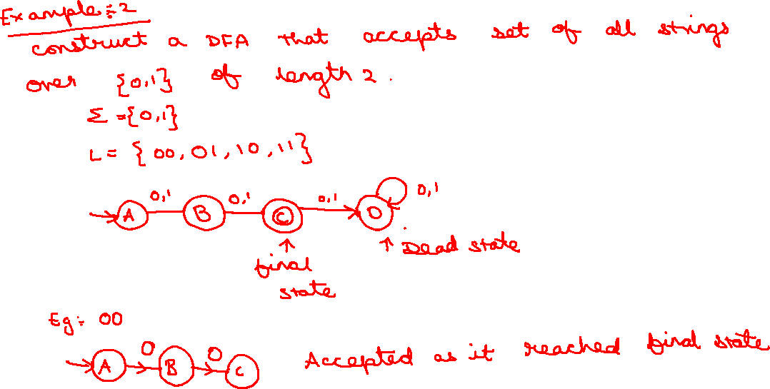

Slide 32
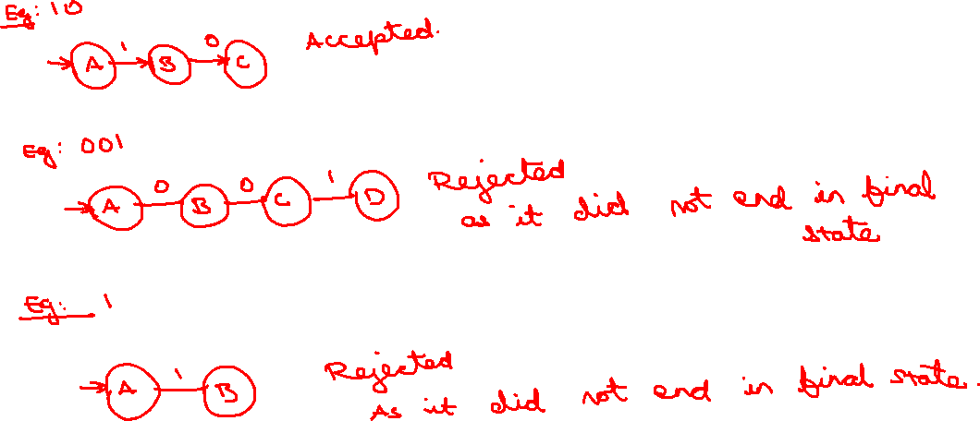

Slide 33
Initial Configuration
head
Input Tape
Input String
Initial state

Slide 34
Scanning the Input

Slide 37
Input finished
accept

Slide 38
A Rejection Case
Input String

Slide 41
Input finished
reject

Slide 42
Another Rejection Case
Tape is empty
Input Finished
reject

Slide 43
Language Accepted:

Slide 44
Another Example
Accept
state
Accept
state
Accept
state

Slide 45
Empty Tape
Input Finished
accept

Slide 46
Another Example
Accept
state
trap state

Slide 47
Input String

Slide 50
Input finished
accept

Slide 51
A rejection case
Input String

Slide 54
Input finished
reject

Slide 55
Language Accepted:

Slide 56
Example 1 – String acceptance
Given a finite automata, M = ({q₀, q₁}, {0, 1}, δ, q₀, {q₁}) and transition diagram as given below:
Check whether the input string 10101 is accepted by M or not.
Check whether the input string 101100 is accepted by M or not.
0
1
q₀
q₁
1
0

Slide 57
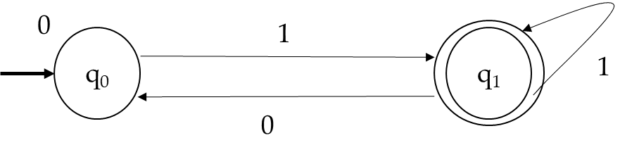
Example 1 – cont…
a) 1 0 1 0 1
b) 1 0 1 1 0 0
The string 10101 is accepted because it ends in the final / acceptance state
q₀
q₁
q₀
q₁
q₀
q₁
Start
Accepted
q₀
q₁
q₀
q₁
q₁
q₀
q₀
Start
Not accepted
The string 101100 is not accepted because it does not ends in the final / acceptance state

Slide 58
Example 2
2. Given a finite automata, M = ({a, b, c, d}, {0, 1}, δ, a, {a}) and transition table as given below:
Check whether the input string 110101 is accepted by M or not.
Check whether the string 110011 is accepted by M or not.
 | 0 | 1
a | c | b
b | d | a
c | a | d
d | b | c

Slide 59
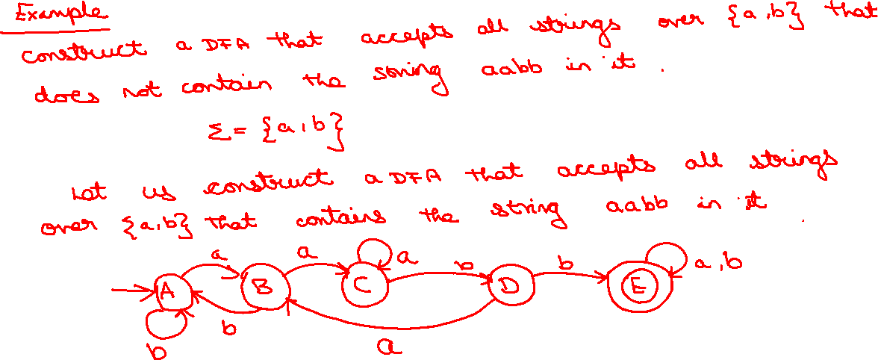

Slide 60
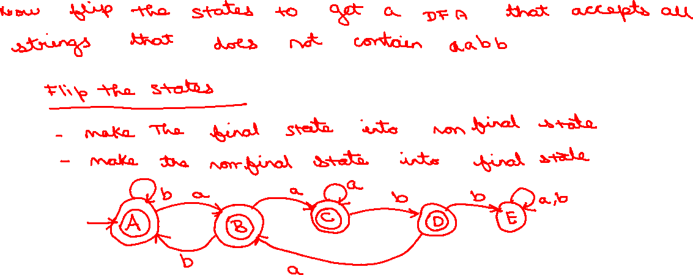

Slide 61
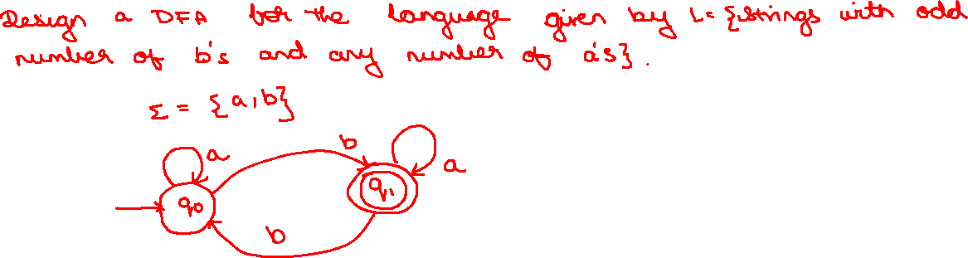

Slide 62
Problems – Construction of DFA
Construct a DFA that accepts all and only the string of 0’s and 1’s that have the sequence 01 somewhere in the string.
Soln:
Language, L = {x 01 y | x and y any strings of 0’s and 1’s}
Alphabet, Σ = {0, 1}
Transition diagram:
1
0
0, 1
start
q₀
0
q₁
1
q₂

Slide 63
Problem 1 – cont…
Transition table
Transition States
δ (q₀, 0) = q₁
δ (q₀, 1) = q₀
δ (q₁, 0) = q₁
δ (q₁, 1) = q₂
δ (q₂, 0) = q₂
δ (q₂, 1) = q₂
Therefore, the Automaton that accepts language L,
A = {(q₀, q₁, q₂), (0, 1), δ, q₀, q₂}
 | 0 | 1
q₀ | q₁ | q₀
q₁ | q₁ | q₂
q₂ | q₂ | q₂

Slide 64
Problem
Construct the DFA’s accepting the following language over the alphabet {0, 1}
The set of all strings ending with ‘00’
The set of strings with three consecutive 0’s
Soln:
a)
1
1
0
start
q₀
0
q₁
0
q₂
1

Slide 65
Problem – cont…
Soln:
b)
1
1
0, 1
q₀
0
q₁
0
q₂
q₃
start
0
1

Slide 66
Problems
Construct DFA that accepts input string of 0’s and 1’s that end with 11
Construct DFA that accepts all strings with three consecutive 1’s at its end
0
0
1
start
q₀
1
q₁
1
q₂
0
0
0
1
q₀
1
q₁
1
q₂
q₃
start
1
0
0

Slide 67
Problems – cont…
Construct DFA for all strings with {0, 1} that has even number of 0’s and 1’s.
Construct DFA for the language L = {0^{n} | n mod 3 = 2, n ≥ 0}
1
A
B
start
1
0
0
0
0
1
C
D
1
start
q₀
0
q₁
0
q₂
0

Slide 68
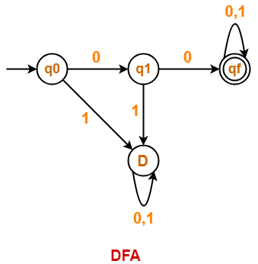
Problems – cont..
Draw a DFA that accepts a language L over input alphabets ∑ = {0, 1} such that L is the set of all strings starting with ’00’.

Slide 69
Problems – DFA to Language
Consider DFA with the following transition table. Find the language accepted by DFA
Consider the following DFA and find language accepted by DFA.
δ | 0 | 1
a | a | b
*b | b | a
δ | 0 | 1
a | a | b
*b | - | c
c | c | b

Slide 70
Problem 1
Soln: The language, L = { w | w is the string with odd number of 1’s}
Problem 2:
Soln: The language, L = { w | w set of strings ends with 1 and has odd number of 1’s}

Slide 71
Non-Deterministic Finite Automata (NFA)
The transition function that takes a state and input symbol as arguments then returns zero or more states.
Example
0, 1
0, 1
start
q₁
1
q₂

Slide 72
Representation of NFA
A NFA can be represented as,
: Finite set of states
: Finite set of Input symbols
: Transition function, Q X {Σ ∪ {ε}} → 2^{Q}
: Initial / Start state
: Set of accepting states

Slide 73
Example: Moves on a Chessboard
States = squares.
Inputs = r (move to an adjacent red square) and b (move to an adjacent black square).
Start state, final state are in opposite corners.
1
2
3
r b
2,4 5
4,6 1,3,5
2,6 5
2,8 1,5,7
2,4,6,8 1,3,7,9
2,8 3,5,9
4,8 5
4,6 5,7,9
6,8 5
4
5
6
7
8
9
r
b
b
1
2
1
5
4
3
1
*
5
3
7
7
9
Accept, since final state reached

Slide 74
Problems – Construction of NFA
Construct NFA for set of all strings {0, 1} that end with string 00.
Soln:
Step 1: Language, L = {w | w is set of all strings that end with string 00}
Step 2: Alphabet, Σ = {0, 1}
Step 3: Transition Diagram
Step 4: NFA, N = [{q₀, q₁, q₂}, {0, 1}, δ, q₀, {q₂}]

Slide 75
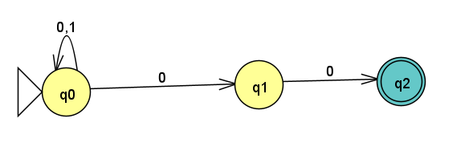
The nfa for the same is:

Slide 76
Problems – Construction of NFA
Construct NFA with abb as substring.
Soln:
Step 1: Language, L = {x | x is set of all strings with abb as substring}
Step 2: Alphabet, Σ = {a, b}
Step 3: Transition Diagram
Step 4: NFA, N = [{q₀, q₁, q₂ , q₃}, {a, b}, δ, q₀, {q₃}]
a, b
a, b
start
q₀
a
q₁
b
q₂
b
q₃

Slide 77
Problems – Cont…
Construct NFA with 101 as substring.
Construct NFA for set of all strings that ends with three consecutive 1’s at its end.
1, 0
1, 0
start
q₀
1
q₁
0
q₂
1
q₃
1, 0
1
start
q₀
1
q₁
1
q₂
1
q₃

Slide 78
Problem 1 – Checking acceptance of string
Construct an NFA for the set of strings with {0, 1} ending with 01 and draw the transition table for the same and check whether the input string 00101 is accepted by NFA.
Soln:
Step 1: Language, L = {x | x is set of all strings ending with 01}
Step 2: Alphabet, Σ = {0, 1}
Step 3: Transition Diagram
Step 4: NFA, N = [{q₀, q₁, q₂}, {a, b}, δ, q₀, {q₂}]
0, 1
0
start
q₀
0
q₁
1
q₂
0, 1

Slide 79
Cont…
0, 1
0
start
q₀
0
q₁
1
q₂
Step 5: Input String = 00101
δ’(q₀, ε) = q₀
δ’(q₀, 0) = δ(q₀, 0) = {q₀, q₁}
δ’(q₀, 00) = δ(δ’(q₀, 0), 0) = δ({q₀, q₁}, 0)
= δ(q₀, 0) ∪ δ(q₁, 0) = {q₀, q₁} ∪ {q₁} = {q₀, q₁}
δ’(q₀, 001) = δ(δ’(q₀, 00), 1) = δ({q₀, q₁}, 1)
= δ(q₀, 1) ∪ δ(q₁, 1) = {q₀, q₂}
δ’(q₀, 0010) = δ(δ’(q₀, 001), 0) = δ({q₀, q₂}, 0)
= δ(q₀, 0) ∪ δ(q₂, 0) = {q₀, q₁}
δ’(q₀, 00101) = δ(δ’(q₀, 0010), 1) = δ({q₀, q₁}, 1)
= δ(q₀, 1) ∪ δ(q₁, 1) = {q₀, q₂}
0, 1

Slide 80
Cont..
Step 6:
To check the acceptance of the string
δ’(q₀, 00101) ∩ F = {q₀, q₂} ∩ {q₂} = {q₂}
Therefore, the string 00101 is accepted.

Slide 81
Problem 2
Consider the given NFA and check whether the input ‘abaab’ is accepted or not.
δ | a | b
→q0 | {q0, q1} | {q0, q3}
q1 | {q2} | φ
*q2 | {q2} | {q2}
q3 | φ | {q4}
*q4 | {q4} | {q4}

Slide 82
NFA with ε - transition
NFA can be extended to NFA-ε transition for an empty string
NFA-ε has 5-tuples, M=(Q, Σ, δ, S, F) [Identical to NFA]
In NFA-ε, there will be a state transition on an input symbol ε
0
start
q₁
ε
q₂

Slide 83
Problems – Construction of NFA-ε
Construct NFA-ε that end with string 11 for the set of all strings {0, 1}
Soln:
Step 1: Language, L = {w | w is set of all strings that end with string 11}
Step 2: Alphabet, Σ = {0, 1}
Step 3: Transition Diagram
Step 4: NFA-ε, NE = [{q₀, q₁, q₂}, {0, 1}, δ, q₀, {q₂}]
0, 1
start
q₀
1
q₁
1
q₂
ε

Slide 84
Problems – cont…
Construct NFA-ε with 011 as substring for set of all strings {0, 1}.
Soln:
Step 1: Language, L = {x | x is set of all strings with 011 as substring}
Step 2: Alphabet, Σ = {a, b}
Step 3: Transition Diagram
Step 4: NFA-ε, NE = [{q₀, q₁, q₂, q₃, q₄}, {0, 1}, δ, q₀, {q₃}]
1, 0
1, 0
start
q₀
0
q₁
1
q₂
1
q₃
ε

Slide 85
Problems – Acceptance of strings
ε-closure: the ε-closure of q₀ [ε-closure(q₀)] denotes the set of all states ‘P’ such that there is a path or transitions from q₀ to P on ε.
  Path from current state to set of states that has ‘ε’ transitions
Consider the following NFA-ε and find the ε-closure for each state and check whether the string ‘abb’ is accepted or not.
Soln:
  ε-closure(q₀) = {q₀, q₁, q₂} [Path from current state to set of states that has ‘ε’ transitions]
  ε-closure(q₁) = {q₁, q₂}
  ε-closure(q₂) = {q₂}
a
b
c
start
q₀
ε
q₁
ε
q₂
a
b

Slide 86
Cont (1)
a
b
c
start
q₀
ε
q₁
ε
q₂
Input string: ‘abb’
δ’(q₀, ε) = ε-closure(q₀) = {q₀, q₁, q₂}
δ’(q₀, a) = ε-closure(δ(δ’ (q₀, ε), a))
= ε-closure(δ({q₀, q₁, q₂}, a))
= ε-closure(δ(q₀,a) ∪ δ(q₁,a) ∪ δ(q₂,a))
= ε-closure({q₀, q₁} ∪ φ ∪ φ)
= ε-closure({q₀, q₁})
= ε-closure(q₀₎ ∪ ε-closure(q₁)
= {q₀, q₁, q₂} ∪ {q₁, q₂}
= {q₀, q₁, q₂}
a
b

Slide 87
Cont (2)
a
b
c
start
q₀
ε
q₁
ε
q₂
δ’(q₀, ab) = ε-closure(δ (δ’ (q₀, a), b))
= ε-closure(δ({q₀, q₁, q₂}, b))
= ε-closure(δ(q₀,b) ∪ δ(q₁,b) ∪ δ(q₂,b))
= ε-closure(φ ∪ {q₁, q₂} ∪ φ)
= ε-closure({q₁, q₂})
= ε-closure(q₁) ∪ ε-closure(q₂)
= {q1, q₂} ∪ {q₂}
= {q₁, q₂}
a
b

Slide 88
Cont (3)
a
b
c
start
q₀
ε
q₁
ε
q₂
δ’(q₀, abb) = ε-closure(δ(δ’ (q₀, ab), b))
= ε-closure(δ({q₁, q₂}, b))
= ε-closure(δ(q₁,b) ∪ δ(q₂,b))
= ε-closure({q₁, q₂} ∪ φ)
= ε-closure({q₁, q₂})
= ε-closure(q₁) ∪ ε-closure(q₂)
= {q₁, q₂} ∪ {q₂}
= {q₁, q₂}
Final State, F = {q₂}
Therefore {q₁, q₂} ∩ F = {q₁, q₂} ∩ {q₂} = {q₂} ==> member in final state
So, the string ‘abb’ is accepted by NFA-ε
a
b

Slide 89
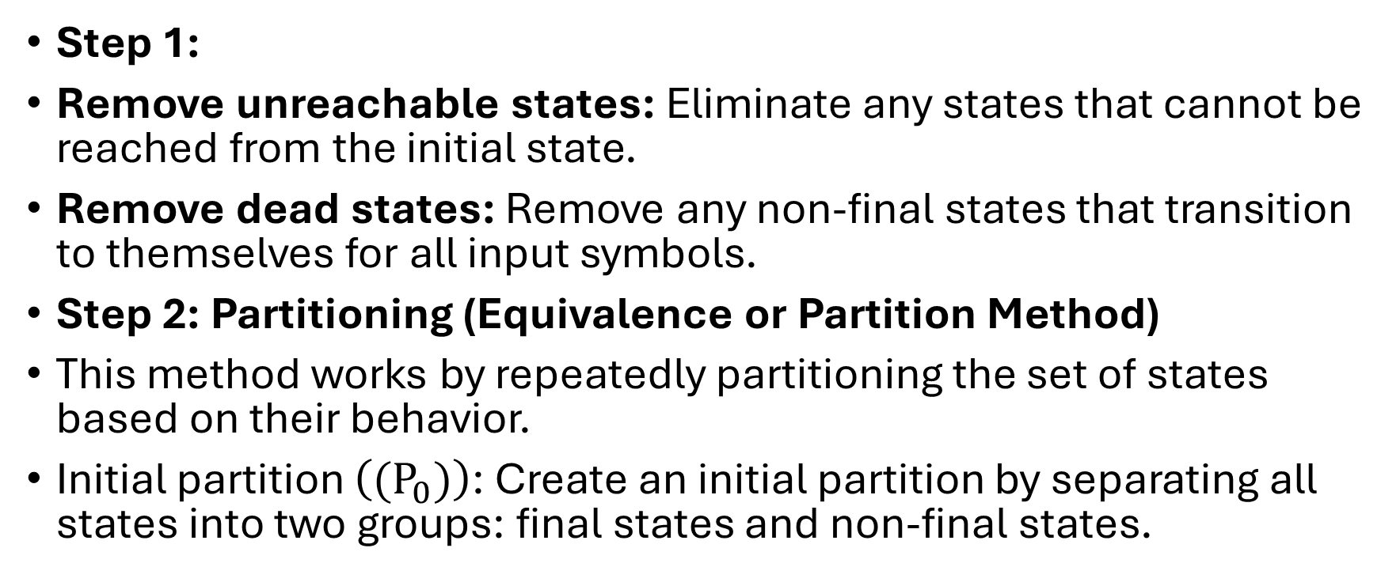
Minimization of Finite Automata
Remove dead states: Remove any non-final states that transition to themselves for all input symbols.
Step 1:
Remove unreachable states: Eliminate any states that cannot be reached from the initial state.
Remove dead states: Remove any non-final states that transition to themselves for all input symbols.
Step 2: Partitioning (Equivalence or Partition Method)
This method works by repeatedly partitioning the set of states based on their behavior.
Initial partition $\left((P_{0})\right)$: Create an initial partition by separating all states into two groups: final states and non-final states.

Slide 90
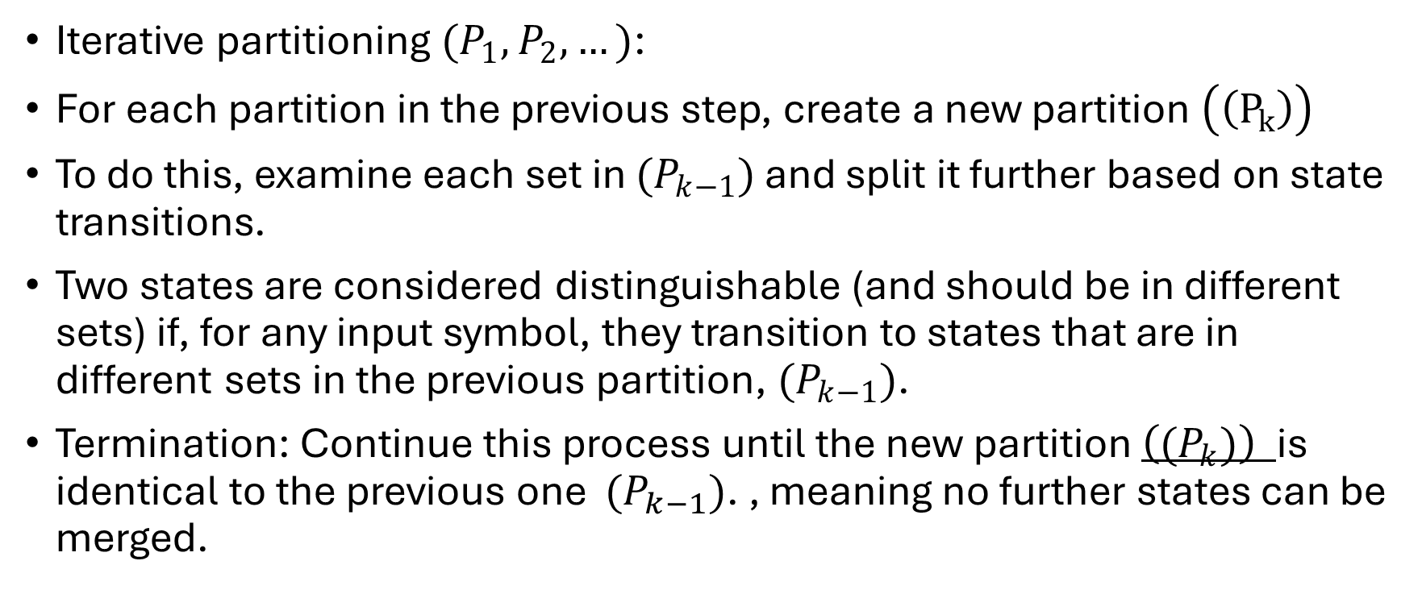
Iterative partitioning $(P_{1},P_{2},…)$:
For each partition in the previous step, create a new partition $\left(\left(P_{k}\right)\right)$
To do this, examine each set in $(P_{k−1})$ and split it further based on state transitions.
Two states are considered distinguishable (and should be in different sets) if, for any input symbol, they transition to states that are in different sets in the previous partition, $(P_{k−1})$.
Termination: Continue this process until the new partition $\left((P_{k})\right)$is identical to the previous one $(P_{k−1})$. , meaning no further states can be merged.

Slide 91
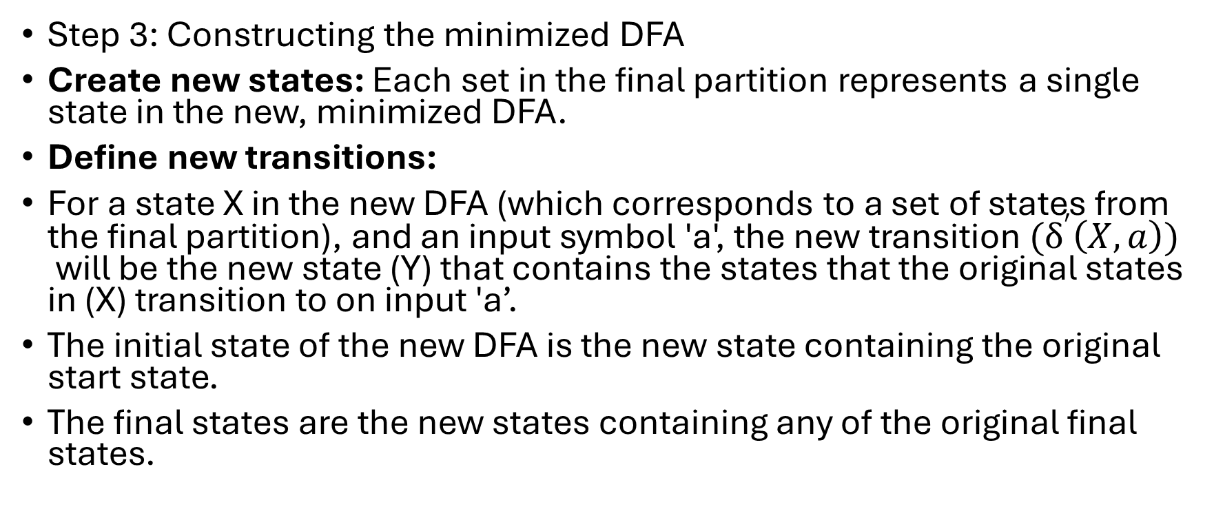
Step 3: Constructing the minimized DFA
Create new states: Each set in the final partition represents a single state in the new, minimized DFA.
Define new transitions:
For a state X in the new DFA (which corresponds to a set of states from the final partition), and an input symbol 'a', the new transition $(δ^{′}\left(X,a\right))$will be the new state (Y) that contains the states that the original states in (X) transition to on input 'a’.
The initial state of the new DFA is the new state containing the original start state.
The final states are the new states containing any of the original final states.

Slide 92
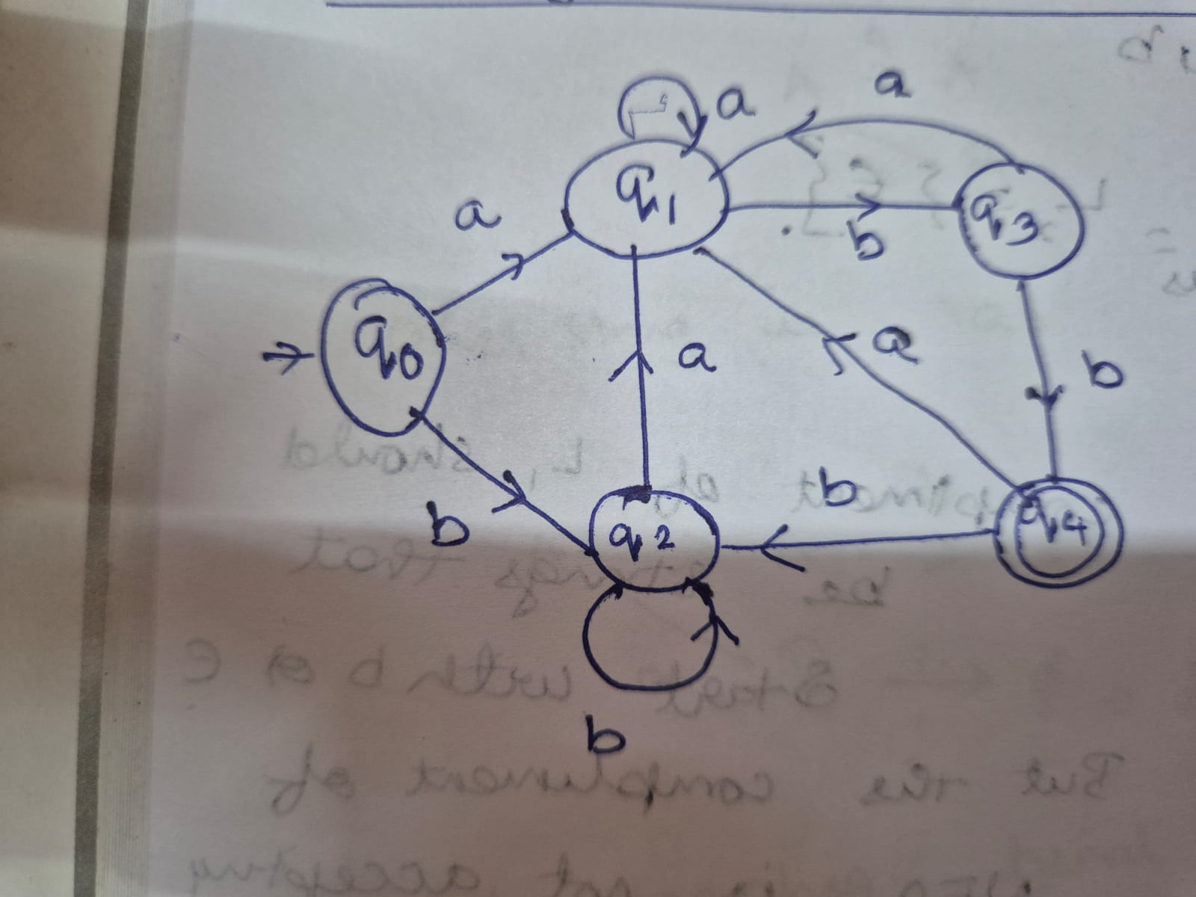
Problem

Slide 93
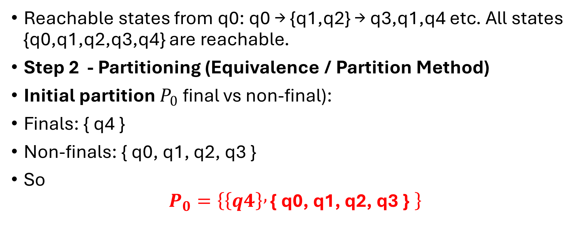
Problem
Reachable states from q0: q0 → {q1,q2} → q3,q1,q4 etc. All states {q0,q1,q2,q3,q4} are reachable.
Step 2 - Partitioning (Equivalence / Partition Method)
Initial partition $P_{0}$final vs non-final):
Finals: { q4 }
Non-finals: { q0, q1, q2, q3 }
So
$P_{0}=\left\{\left\{q4\right\} , \text{\{ }\text{q}\text{0}\text{, }\text{q}\text{1}\text{, }\text{q}\text{2}\text{, }\text{q}\text{3 }\text{\} }\right\}$

Slide 94
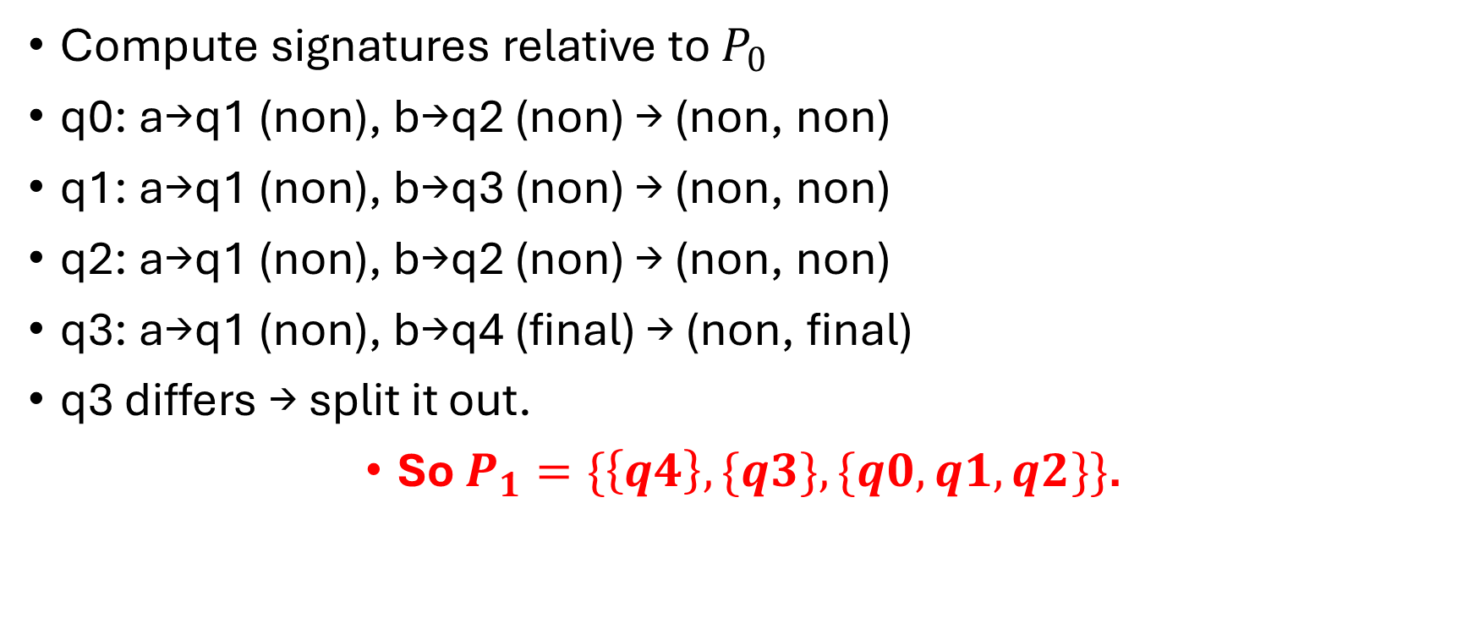
Compute signatures relative to $P_{0}$
q0: a→q1 (non), b→q2 (non) → (non, non)
q1: a→q1 (non), b→q3 (non) → (non, non)
q2: a→q1 (non), b→q2 (non) → (non, non)
q3: a→q1 (non), b→q4 (final) → (non, final)
q3 differs → split it out.
So $P_{1}=\{\left\{q4\right\},\{q3\}, \{q0,q1,q2\}\}$.

Slide 95
Refine to 𝑃2 ​ (relative to 𝑃1 ​)
Label blocks: X1={q4}, X2={q3}, X3={q0,q1,q2}.
Compute signatures (targets mapped to X1/X2/X3):
q0: a→q1 ∈ X3, b→q2 ∈ X3 → (X3, X3)
q1: a→q1 ∈ X3, b→q3 ∈ X2 → (X3, X2)
q2: a→q1 ∈ X3, b→q2 ∈ X3 → (X3, X3)
So q1 is distinct within X3. Split it.
Thus 𝑃2={{𝑞4}, {𝑞3}, {𝑞1}, {𝑞0,𝑞2}}

Slide 96
Check stability (next refinement)
Label Y1={q4}, Y2={q3}, Y3={q1}, Y4={q0,q2}.
Compute signatures:
q0: a→q1 ∈ Y3, b→q2 ∈ Y4 → (Y3, Y4)
q2: a→q1 ∈ Y3, b→q2 ∈ Y4 → (Y3, Y4) (same as q0)
q1: a→q1 ∈ Y3, b→q3 ∈ Y2 → (Y3, Y2)
q3: a→q1 ∈ Y3, b→q4 ∈ Y1 → (Y3, Y1)
q4: a→q1 ∈ Y3, b→q2 ∈ Y4 → (Y3, Y4)
No further splits (each block’s members share signatures). So 𝑃2 ​ is the final partition. Final partition:{{𝑞4}, {𝑞3}, {𝑞1}, {𝑞0,𝑞2}}.

Slide 97
Construct the Minimized DFA.
Each final block becomes one state. Let’s name them:𝐴=[𝑞0,𝑞2] - start state (contains q0)
𝐵=[𝑞1]
𝐶=[𝑞3]
𝐷=[𝑞4] - final
Compute transitions (pick representative from each block):
From A (use q0):on a: q0 → q1 ∈ B ⇒ δ'(A,a)=B
on b: q0 → q2 ∈ A ⇒ δ'(A,b)=A

Slide 98
From B (q1):
on a: q1 → q1 ∈ B ⇒ δ'(B,a)=B
on b: q1 → q3 ∈ C ⇒ δ'(B,b)=C
From C
(q3):on a: q3 → q1 ∈ B ⇒ δ'(C,a)=B
on b: q3 → q4 ∈ D ⇒ δ'(C,b)=D
From D (q4):
on a: q4 → q1 ∈ B ⇒ δ'(D,a)=B
on b: q4 → q2 ∈ A ⇒ δ'(D,b)=A

Slide 99
Minimized DFA summary States: { A, B, C, D }Start state: A Final states: { D }Transition table:
State | on `a` | on `b`
A | B | A
B | B | C
C | B | D
D | B | A

Slide 100
Regular Expressions (REs)
A notation used to define formal languages.
Can be viewed as a simple programming language for describing patterns in text.
Widely used in:
Text-search applications
Compiler design
Software components
Regular expressions define exactly the same languages as finite automata.

Slide 101
Regular Expressions (REs)
Used to describe about the structure of data
Regular Language - Languages defined by the regular expression
REs gives the declarative ways to express / represent the strings

Slide 102
Example:
01* + 10*
represents all strings that are either:
A single 0 followed by any number of 1s, or
A single 1 followed by any number of 0s

Slide 103
Operations on REs
Union (U):
  The union of two languages L and M, denoted L U M is the set of strings that are in either L or M or both
  Ex: L = {001, 10, 11} and M = {ε, 001} and L U M = {ε, 10, 11, 001}
Concatenation (.):
  The concatenation of languages L and M is the set of strings that can be formed by taking in any string in L and concatenating it with any string in M
  Ex: L = {001, 10, 11} and M = {ε, 001} and L . M = {001, 10, 11, 001001, 10001, 11001}

Slide 104
3. The closure (or star, or Kleene closure)
The closure (or star, or Kleene closure) of a language L is written as L*.
It represents all strings that can be formed by:
Taking any number of strings from L (including zero strings),Repetition allowed, Concatenating them in any order
L* Includes
ε (empty string)
Selecting zero strings from L.

Slide 105
All strings formed using 1 choice from L
This is L¹ = L.
All strings formed using 2 choices from L
This is L² = L · L (concatenation).
All strings formed using any number of choices
L³, L⁴, … and so on.
Therefore:
L* = {ε} ∪ L¹ ∪ L² ∪ L³ ∪ …

Slide 106
Example: L = {0, 11}
L⁰ = {ε}
(select zero strings)
L¹ = L = {0, 11}
L²: pick two strings from L (repetition allowed)
→ {00, 011, 110, 1111}
L³: pick three strings from L
→ {000, 0011, 0110, 1100, 01111, 11011, 11110, 111111}
To compute L*, take the union of L⁰, L¹, L², L³, …Each Lᶦ is finite (2ᶦ strings),but the union of infinitely many Lᶦ gives an infinite language.

Slide 107
Example: L = set of all strings of 0’s
L is infinite.
L⁰ = {ε}
L¹ = L (all strings of 0’s)
L² = concatenation of two strings of 0’s ⇒ still all strings of 0’s
Therefore,
L* = L ∪ {ε} = all strings of 0’s including ε.

Slide 108
Building Regular Expressions
1. Starting with Basic Elements
All algebras begin with elementary expressions such as:
  Constants
  Variables
Complex expressions are built using operators and grouping symbols (e.g., parentheses).

Slide 109
2. Regular Expression Algebra
Follows the same idea as arithmetic algebra.
Uses:
  Constants / variables that denote languages
  Operators:
    Union ( + )
    Concatenation ( ⋅ )
    Kleene Star ( * )
Regular expressions are defined recursively.
For each regular expression E, the language it represents is written as L(E).

Slide 110
3. Use of the Star Operator
Similar to using Σ* on an alphabet:
Forms all strings from symbols of Σ.
Kleene star on a language L*:
  Builds all strings formed from any number of strings in L.
Important distinction:
  L = set of strings
  Σ = set of symbols
  But L* behaves like Σ* when L contains all strings of length 1 from Σ.

Slide 111
BASIS (Building Blocks of Regular Expressions)
Constants
  ε and ∅ are regular expressions.
  L(ε) = {ε}, L(∅) = ∅.
Symbols
  If a is a symbol, then a is a regular expression.
  Represents the language {a}, i.e., L(a) = {a}.
Variables
  A capital italic letter like L represents any language.

Slide 112
INDUCTIVE RULES (Constructing Complex Regular Expressions)
Union
  If E and F are regular expressions,
  E + F is also a regular expression.
  L(E + F) = L(E) ∪ L(F).
Concatenation
  If E and F are regular expressions,
  EF is a regular expression.
  L(EF) = L(E) L(F) (concatenation of languages).
Kleene Star
  If E is a regular expression, E* is also a regular expression.
  L(E*) = (L(E))*.
Parentheses
  If E is a regular expression, then (E) is also a regular expression.
  Represents the same language: L((E)) = L(E).

Slide 113
Example – Build a regular expression for strings with alternating 0 and 1.
Step 1: Start with the basic alternating unit
Single alternating block = 01
By basis rules:
  0 represents {0}
  1 represents {1}
Concatenation gives the expression 01, representing {01}.

Slide 114
Step 2: Get multiple occurrences
To generate strings like:
01, 0101, 010101, …
we apply the Kleene star:
(01)*
Parentheses are needed:
  01* means “0 followed by any number of 1’s,”
  which is different.

Slide 115
Strings with alternating 0’s and 1’s can fall into four categories:
Start with 0 → end with 1 → (01)*
Start with 1 → end with 0 → (10)*
Start with 0 → end with 0 → 0(10)*
Start with 1 → end with 1 → 1(01)*
Combined Regular Expression
(01)∗+(10)∗+0(10)∗+1(01)∗
This union covers all alternating 0–1 strings of any length.

Slide 116
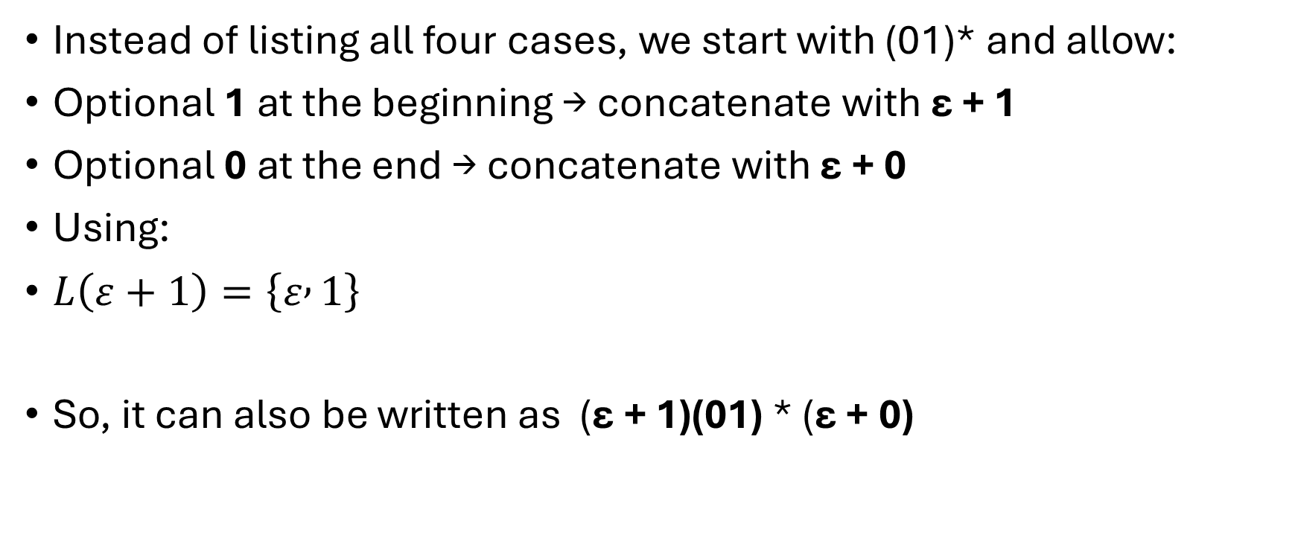
Instead of listing all four cases, we start with (01)* and allow:
Optional 1 at the beginning → concatenate with ε + 1
Optional 0 at the end → concatenate with ε + 0
Using:
$L\left(ε+1\right)=\left\{ε , 1\right\}$
So, it can also be written as (ε + 1)(01) * (ε + 0)

Slide 117
Precedence of Regular Expression Operators
Closure operator (*)
Dot Operator (.)
Union operator (+)
Note:
  Operator are grouped from left to right
  Ex: 012 can be grouped as (01) 2 by default
  Use parenthesis to override 0(12)
  Ex: The expression 01*+1 is grouped as:
2
1
3

Slide 118
Regular Expression to Language
Regular Expression | Language
1* or 0* | Any number of 1s or any number of 0s
1 or 0 | One occurrence of 1 (or) 0
01 | No other 0’s and 1’s except the string 01 [i.e., 01 appears only once]
(01)* | All strings that repeat 01 zero or more time
01* | String consists of 0 followed by any number of 1’s
0 + 1 [Ex: 01, 0 , 1] | String consisting of one 0 or string consisting of one 1 or sting consisting of 01
(a + b)* [Ex: { ε, a, b, aa, ab, bb, ba, aaa…….} | Set of strings of a’s and b’s of any length including the null string
0 + 1* | String consisting of 0 or any number of 1’s [String may or may not have Zero]

Slide 119
Language to Regular Expression
Language | Regular Expression
Set of all strings of Zero or more a’s | a*
Set of all strings of a’s and b’s of length two | (a+b) (a+b)
Set of all strings over {a, b} ending with ‘aba’ | (a+b)* aba
Set of all strings over {0, 1} starting and ending with 0 | 0 (0+1)* 0
Set of all strings over {a, b, c} with any number of a’s followed by any number of b’s followed any number of c’s | a* b* c*

Slide 120
Language to Regular Expression – cont…
Language | Regular Expression
Set of all strings over {a, b, c} with at least one ‘a’ followed by at least one ‘b’ followed at least one ‘c’ | a⁺ b⁺ c⁺
Set of all strings with zero or more instances of a or b | (a + b)* or (a* b*)*
Set containing the string 0 and all strings consisting of zero or more 0’s followed by single 1 | 0 + 0* 1
Set of string over {1} having odd length of 1 | 1 (11)*
Set of all strings over 0 and 1 that contain the substring 111 | (0+1)* 111 (0+1)*

Slide 121
a) Strings over {a, b, c} with at least one a and at least one b
Answer:
(a+b+c)∗a(a+b+c)∗b(a+b+c)∗+(a+b+c)∗b(a+b+c)∗a(a+b+c)∗
b) Strings of 0’s and 1’s whose 10th symbol from the right is 1
Answer:
(0+1)∗1(0+1)⁹

Slide 122
Converting Regular Expression to Finite Automata
Construct the FA for the regular expression, R = 01
Construct the FA for the regular expression, R = 0+1

Slide 123
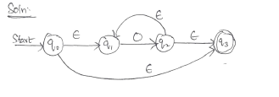
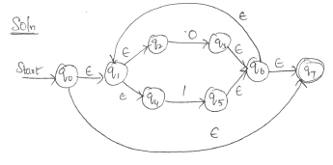
RE to FA – cont…
Construct the FA for the regular expression, R = 0*
Construct the FA for the regular expression, R = (0+1)*

Slide 124
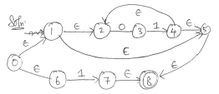
RE to FA – cont…
Construct the FA for the regular expression, R = (01)* + 1

Slide 125
Regular Languages
Regular languages are the class of languages that can be represented using finite automata, regular expressions, or regular grammar. These languages have predictable patterns and are computationally efficient to recognize.

Slide 126
Properties of Regular Languages
Regular languages are closed under operations like union, concatenation, and Kleene star.
Complementation
  If a language L is regular its complement L' is regular.
Union
  If L₁ and L₂ are regular, then L₁ ∪ L₂ is regular.
Intersection
  If L₁ and L₂ are regular, then L₁ ∩ L₂ is regular.
Concatenation
  If L₁ and L₂ are regular, then L₁ . L₂ is regular.

Slide 127
Kleene star
  If L is regular, then L* is regular.
Difference
  If L₁ and L₂ are regular, then L₁ - L₂ is regular.
Reverse
If L is regular, then L^{R} is regular.
  Let DFA(L) denote the DFA of L. Make the following modifications to construct DFA(L^{R}).
  Change the start state of DFA(L) to the final state. Change the final state of DFA(L) to the start state.
  In case there are more than one final state in DFA(L), first add a new final state and add ε- transitions from the final states (which now cease to be final states any more) and perform this step.
  Reverse the direction of the arrows.

